Slide 1
DATAPIPE
Incremental ML data pipelines
Live demo — teaching a detector to see in the dark
· Cat/dog detection that fails at night
· Fix it live: add tagged data → retrain → watch the metric rise
· Reproducible · observable · resumable
1 / 14
Notes:
SAY: Datapipe builds durable, incremental ML data pipelines.
Today’s demo: a cat/dog detector that fails at night. We will add tagged data, retrain, and watch the night metric rise — live, with full observability.

Slide 2
What is Datapipe?
A Python framework for durable, incremental batch processing
images
split
train
inference
metrics
fiftyone
New images arrive
Rerun from here — only changed rows recompute downstream
Config / hyperparams change
Rerun from train — earlier stages stay cached
Record-level tracking
Change one input row → only its downstream steps re-run
Durable state
Interrupted run resumes where it stopped
Cheap iteration
No “rerun everything” — safe to fail and retry
2 / 14
Notes:
SAY: A pipeline is a graph of tables connected by transforms.
Datapipe tracks dependencies per record: change one input row → only its downstream steps re-run. State is persisted, so a crash resumes where it left off.
Point at the callouts: new images restart from load; a train-config change can leave earlier stages cached.

Slide 3
How we work with Datapipe
Three surfaces, one pipeline
01
02
03
Python
Agentic Skills
Datapipe UI
Define the pipeline as code:
tables, transforms, stages.
Agent sets up, loads data,
verifies, and hands off.
Graph, training, metrics,
and run triggers — live.
3 / 14
Notes:
SAY: One pipeline, three surfaces.
1) Python — you define tables, transforms, stages.
2) Agentic Skills — the agent sets up the env, loads data, verifies it’s in the pipe, then hands off. It does not run training.
3) Datapipe UI — graph, training curves, metric tables, and the Run button you press.

Slide 4
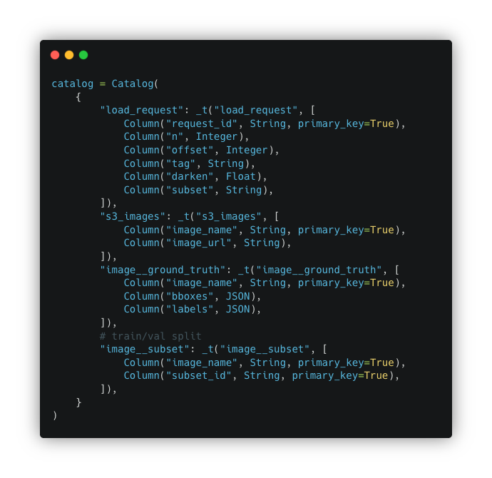
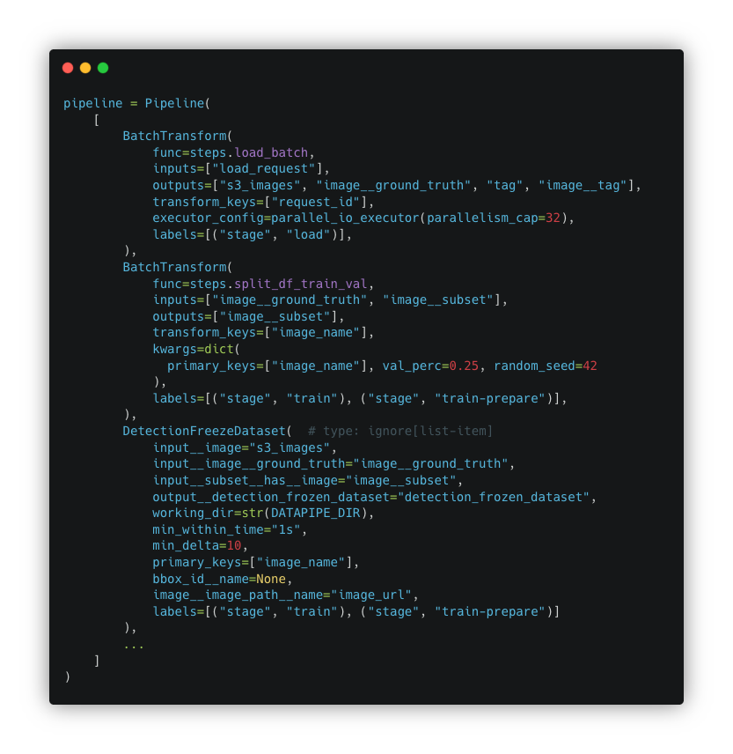
Python — define the pipeline
Catalog (tables) + Pipeline (transforms)
Catalog
Pipeline
4 / 14
Notes:
SAY: Two building blocks in code.
Catalog = the tables (images, ground truth, tags, subsets).
Pipeline = the transforms that move data between them.
Walk load → split → freeze → train briefly; this is what the UI graph will show.

Slide 5
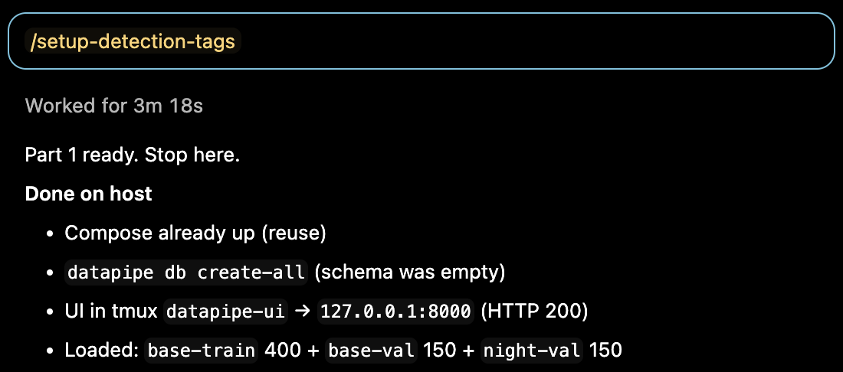
Agentic Skills — environment setup
Skill checks what is already running before it installs or changes anything
✓
Prebuilt environment activated
torch + FiftyOne already available
✓
Services responding
Postgres, MinIO, MongoDB
✓
Ports & schema confirmed
Nothing overwritten blindly
5 / 14
Notes:
SAY: Before installing anything, the skill checks ports, Compose, DB/schema, and the venv — and reuses what is already there.
Then it loads part-1 data (base + night-val), verifies counts, and stops.
You trigger model-A training yourself from the UI.

Slide 6
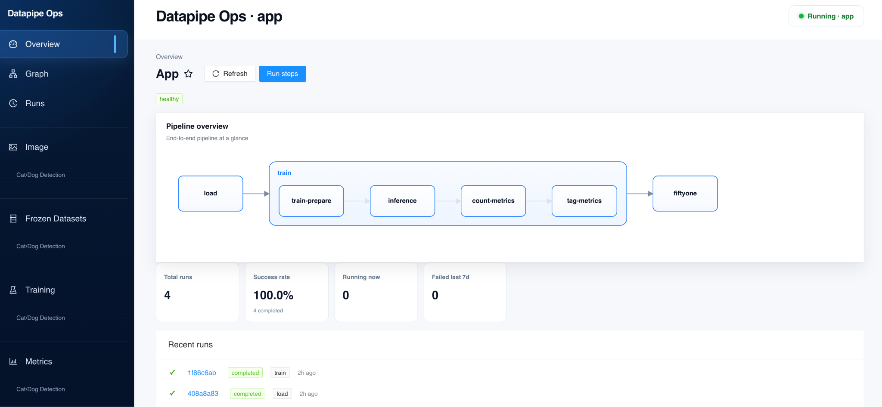
Retrain from the UI
Graph · observability · metric tables · run triggers
6 / 14
Notes:
SAY: Open the live UI (localhost:8000, tunnel if remote).
Show: pipeline graph, Run steps, training status/curves, and the cat/dog metrics pages.
Model A was launched from here; model B will be too — same surface.

Slide 7
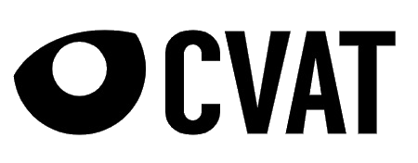





Integrations
Batteries included for ML data work
ANNOTATION
ANNOTATION
VISUALIZATION
Label Studio
CVAT
FiftyOne
TRAINING
DATABASE
OBJECT STORAGE
YOLO / Ultralytics
PostgreSQL
MinIO / S3
7 / 14
Notes:
SAY: Datapipe wires the usual ML stack so they stay in sync.
This demo: YOLO for train/infer, FiftyOne for visual QA, Postgres + MinIO underneath.
Label Studio / CVAT are available for real annotation — not used today because ground truth is injected.

Slide 8
LIVE DEMO
Teaching a detector to see in the dark
Find a weak scenario → add tagged data → retrain → prove the lift
8 / 14
Notes:
SAY: Live demo starts now.
Promise in one line: find the weak scenario (night) → add tagged train data → retrain → prove the lift on the same frozen validation set.

Slide 9
The problem
We have a model, a dataset, and metrics — but it underperforms in production
WHAT WE HAVE
THE QUESTION
Cat & dog detection model
Trained on COCO images with injected ground truth
Overall metrics look fine
How do we automate retrain without losing transparency?
Annotate new examples → add to training → retrain → measure again — and repeat.
WHAT WE FOUND
Model is less accurate at night
Aggregate metric hides the failure — we need per-scenario metrics (tags)
The answer — Datapipe
9 / 14
Notes:
SAY: We already have a model, data, and overall metrics that look fine — but production fails at night.
Aggregate metric hides that. Tags slice metrics by scenario so the blind spot becomes a number.
Question: how do we automate retrain without losing transparency? Datapipe.
THEN: FiftyOne — filter fields tag_id=night and subset_id=val (not native tags). Show GT vs predictions_model_a misses.

Slide 10
Data layout
Val frozen up front — only TRAIN grows between model A and model B
Part 1
Part 1
Part 1
Part 2
400
150
150
300
base-train
base-val
night-val
night-train
subset = train
standard images
subset = val
base validation
subset = val
tag = night
subset = train
tag = night
Val stays frozen (150 + 150). Part 2 only adds night-train → fair A-vs-B comparison.
10 / 14
Notes:
SAY: Why this load order matters.
Val is frozen up front: 150 base-val + 150 night-val. If val changed between A and B, the metric would move even with an identical model.
Part 2 only adds night-train (300). Optional beat: three darkness levels so B generalizes low light instead of memorizing one gamma.

Slide 11
Metrics after 1st training run
Model A baseline — switch to the live UI
→ Open Metrics in Datapipe UI
Show model_metrics + tag_metrics Focus: night / val is low — the blind spot
11 / 14
Notes:
SAY: Switch to UI metrics — model_metrics and tag_metrics.
Point at night/val for model A: low. That is the failure mode.
Remind: we will remeasure on the exact same val after retrain.
THEN (if not done on slide 9): quick FiftyOne night-val false negatives.

Slide 12
What should we do next?
Four steps — happening live now
1
2
3
4
Ask the agent
Run training
Check metrics
Visualize
Add night-train
data (part 2)
Trigger model B
from the UI
tag_metrics in UI
night / val ↑
FiftyOne: model B
vs model A
12 / 14
Notes:
SAY while executing:
1) Ask the agent to load night-train (part 2). Skill loads + verifies, then stops.
2) You press Run train in the UI → model B. Point audience at training curves / log.
3) Run count-metrics (re-run once if it reports 0 batches).
4) Refresh FiftyOne for predictions_model_b.

Slide 13
Model B improves night / val
Same frozen validation set — fair comparison
Comparison: tag = night · subset = val
A → B
validation | model A | model B
val (overall) | — live UI — | — live UI —
val · night | — live UI — | — live UI —
night / val metric ↑
Measured on the same 150 night-val images
Fill live numbers from UI
Then FiftyOne: predictions_model_b catches what model A missed
13 / 14
Notes:
SAY: Same 150 night-val images — so A→B is fair.
Fill the table from the live UI (prefer weighted F1; recall is fine as secondary). night/val should rise; overall should not regress.
THEN: FiftyOne — predictions_model_b vs model_a on night-val. Quote this run’s delta; don’t promise a fixed number.

Slide 14
Why Datapipe
Unique value — and what you just saw
Incremental by design
Per-scenario metrics (tags)
One pipeline, three surfaces
Only changed rows recompute.
Add a batch, retrain — don’t
rebuild the world.
Blind spots become numbers
you can move — night/val,
not just overall metric.
Python defines it.
Skills operate it.
UI observes and triggers runs.
WHAT YOU JUST SAW
1
Night fails
2
Tags expose it
3
Freeze val
4
Add + retrain
5
Prove lift
overall looked fine
night / val low
fair A → B
night-train → model B
same val, metric ↑
Real data: same pipeline — drop injected GT, synthetic darkening, demo checkpoint. Keep frozen val + tags.
14 / 14
Notes:
SAY: Recap the loop as the strip: night fails → tags expose it → freeze val → add data & retrain → prove the lift.
Then hit the three UVPs: incremental (cheap iteration), tags (actionable blind spots), one pipeline across code / agent / UI.
Close: same pipeline for real data — drop demo-only bits; keep frozen val and tags.

